Slide 1

Azure Multi-Model: Cryptocurrency Price Prediction
Team 4:- Diya Baldota Rucha Chotalia Hardik Sodhani Shreyansh Goushal

Slide 2

Contents
Introduction
Objective and Scope
Architecture Diagram
Graph Data Model
Code Snippets
Visualization by Power BI

Slide 3

Project Scope/Objectives
The objective of this project is to create a cryptocurrency price prediction model using Azure multi-model that can help us forecast future prices. The scope of this project includes the following:
Collecting data on cryptocurrency prices and other relevant factors
Building a graph data model to represent the data
Using Azure multi-model to create a prediction model
Visualizing the results using Power BI

Slide 4
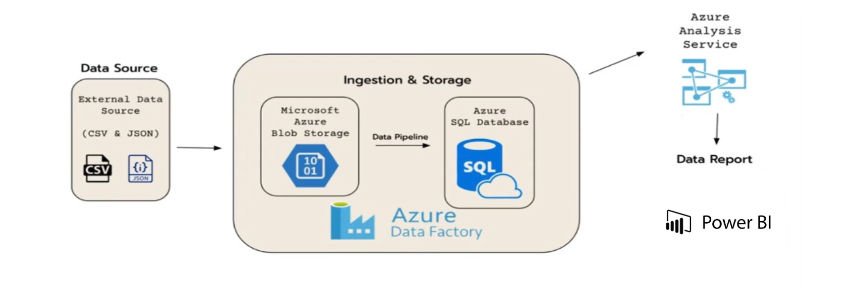
Architecture Diagram

Slide 5
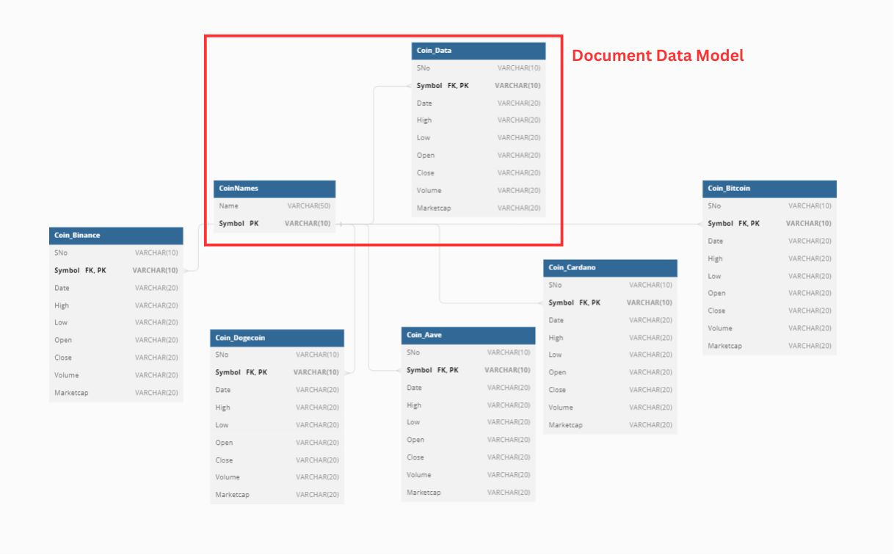
ER Diagram

Slide 6
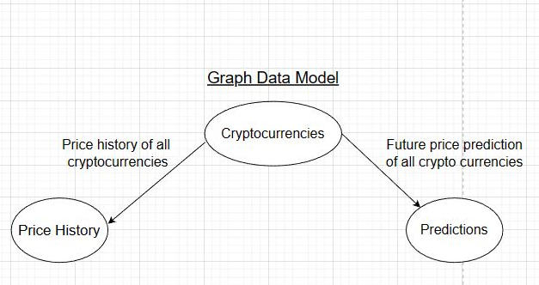
Graph Data Model
The graph data model offers a lot of flexibility in representing complex relationships between data. In the context of cryptocurrency, this can be particularly useful in understanding the behavior of different coins over time. For example, by connecting the cryptocurrency node to the prediction node and the price history node, we can create a comprehensive visualization of how the coin has performed historically and how it is predicted to perform in the future. This can be used by traders and investors to make informed decisions about buying or selling the cryptocurrency. Additionally, by incorporating other data sources into the graph model, such as news articles or social media sentiment, we can create an even richer and more informative representation of the cryptocurrency ecosystem. Overall, the graph data model is a powerful tool for analyzing and understanding complex data structures, such as those found in the cryptocurrency space.

Slide 7
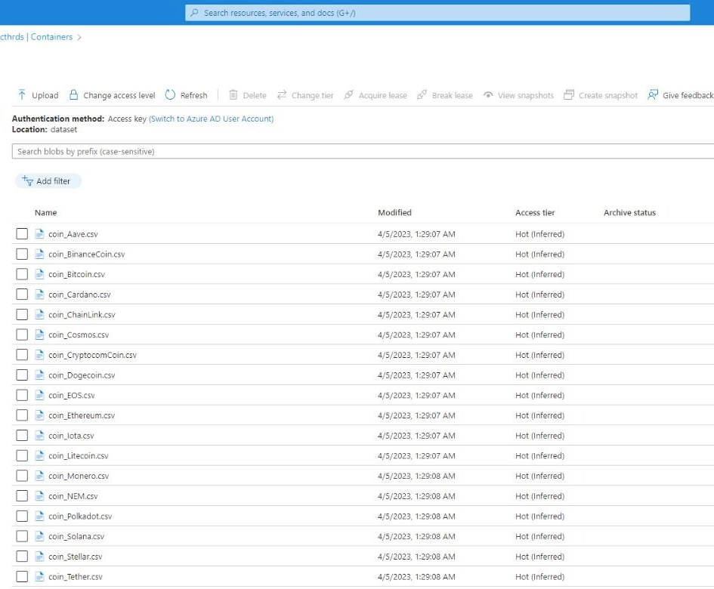
Azure Blob Storage
The steps we followed to load data from Azure Blob Storage to Azure SQL Server using Azure Data Factory:
Created an Azure Blob Storage account and uploaded our data to the account in csv. format.
Navigated to the Azure portal and created a new Azure SQL Database and server.
Created a Linked Service in Azure Data Factory
Created a Dataset in Azure Data Factory

Slide 8
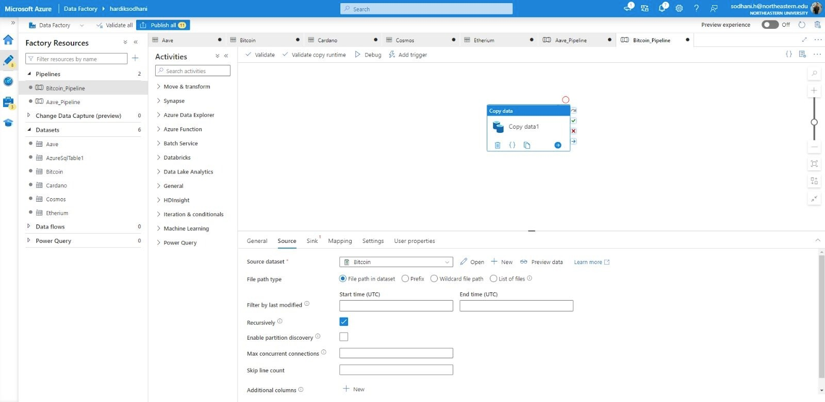
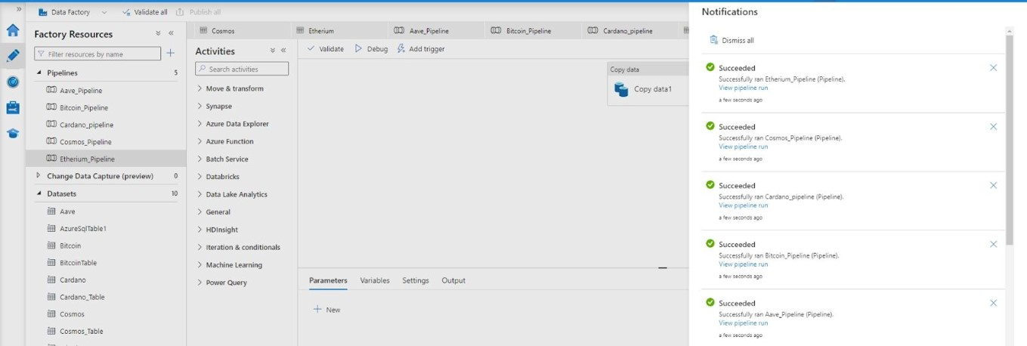
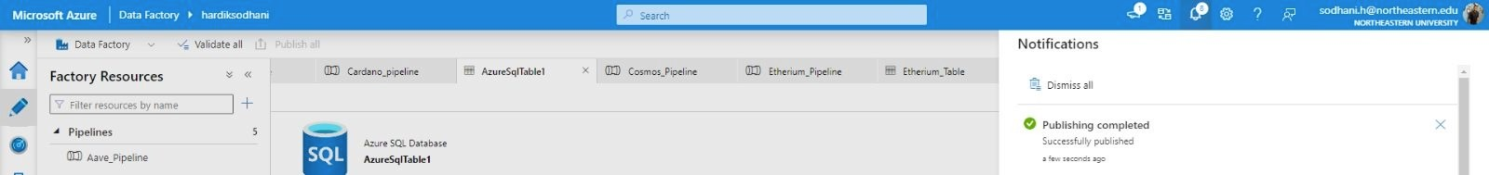
Creating Pipelines

Slide 9
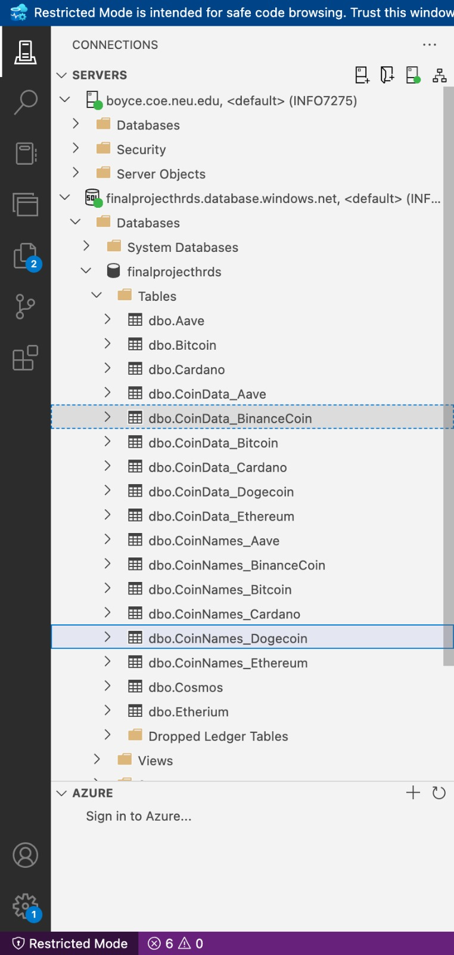
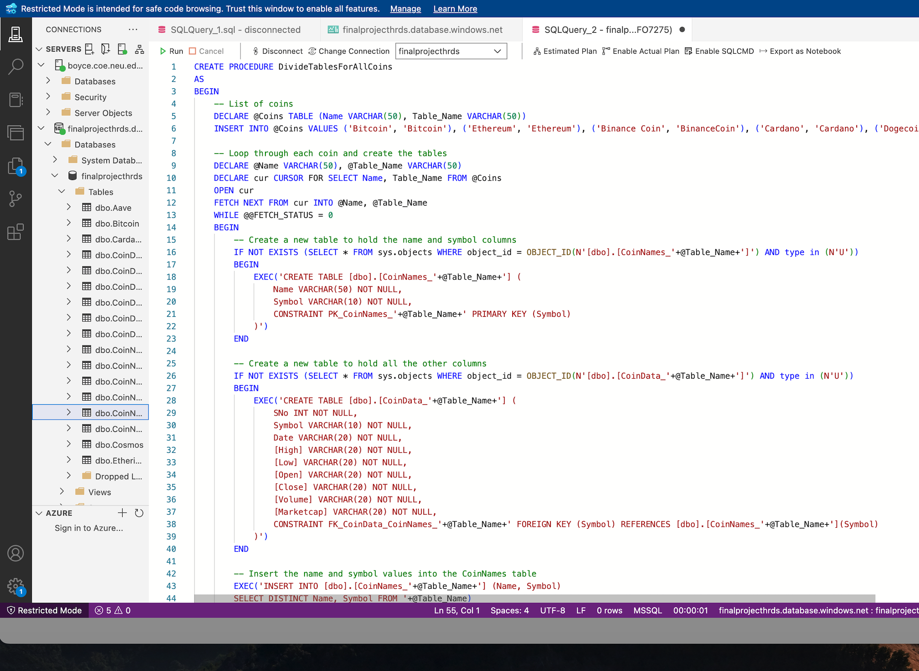
Stored Procedure
A stored procedure was generated from the primary table comprising all the available coins. This procedure effectively segregated the data into two distinct tables - the first table contained the names of the coins while the second table contained the relevant coin data.

Slide 10
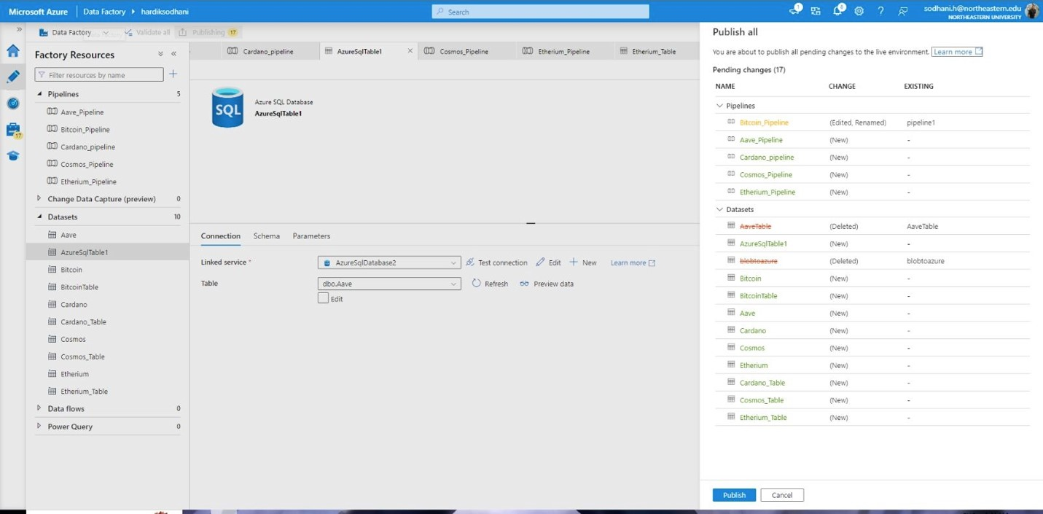
Azure Data Server
The data was successfully imported from Azure Blob Storage to Azure SQL Server.
The tables that we uploaded, were visible on the Azure SQL Server.

Slide 11
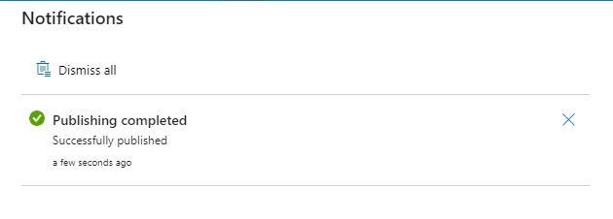
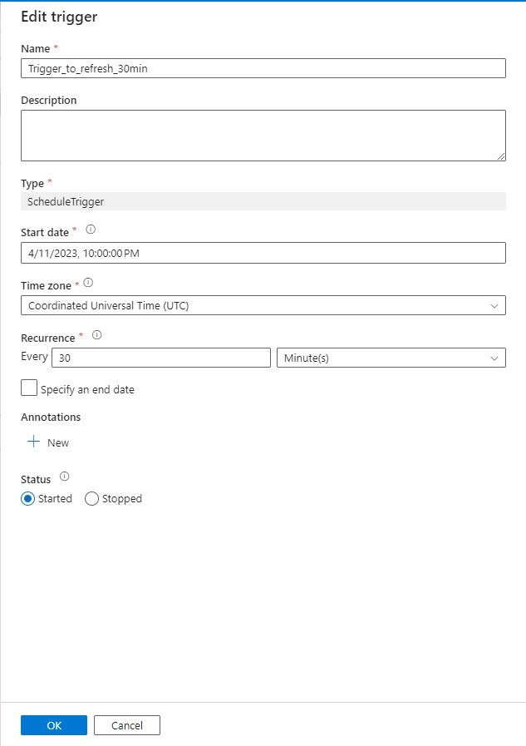
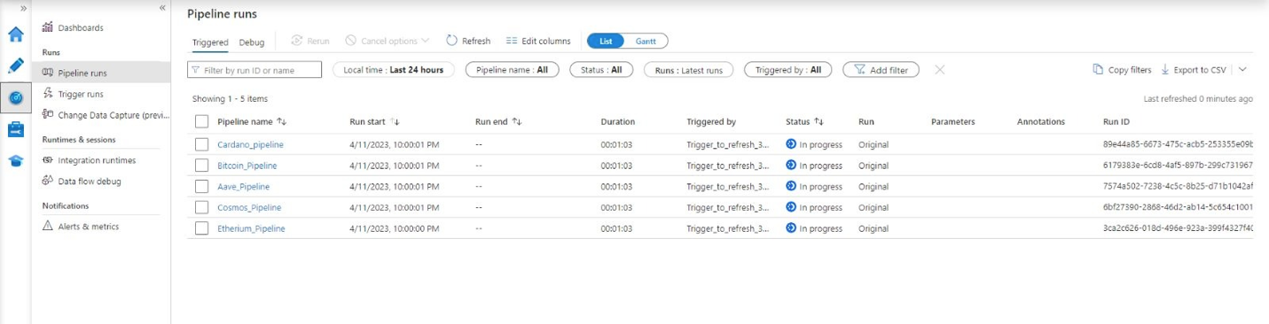
Triggers
A trigger was successfully scheduled to initiate the execution of pipelines every 30 minutes through Azure Data Factory. The trigger was efficiently deployed and subsequently assigned to each pipeline. Upon running on the designated schedule, the trigger's status indicated "In progress". It is noteworthy that all the pipelines executed seamlessly, with each task completing successfully.

Slide 12
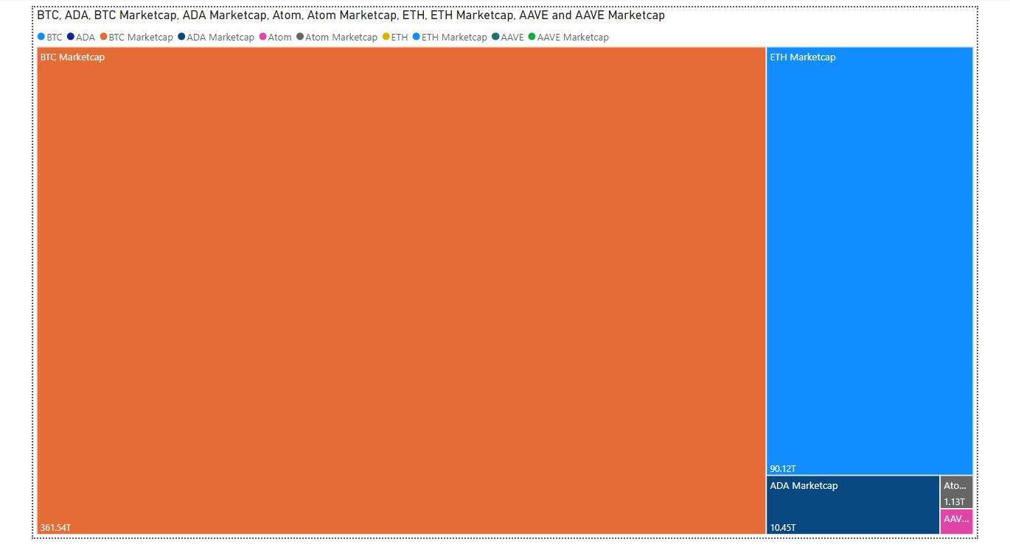
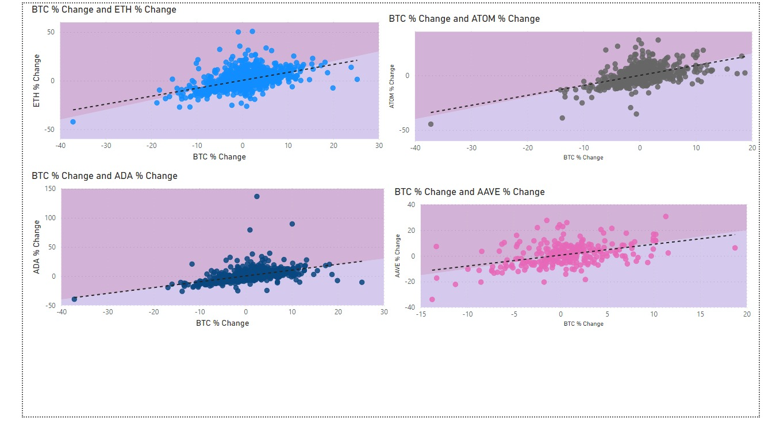
Visualization using PowerBI

Slide 13
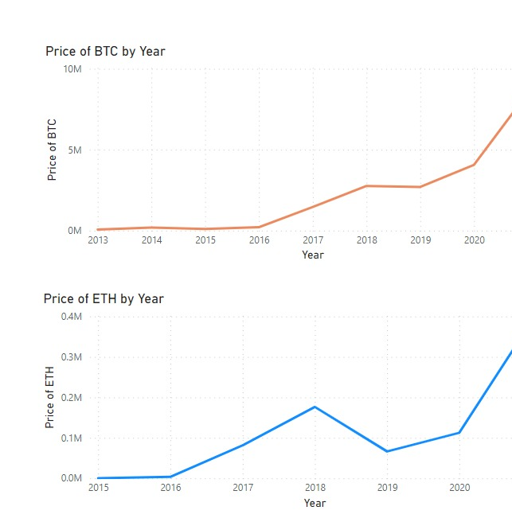
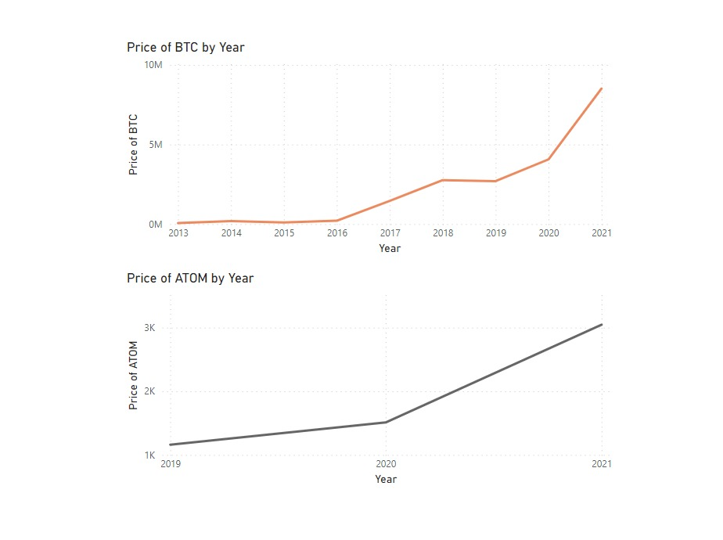
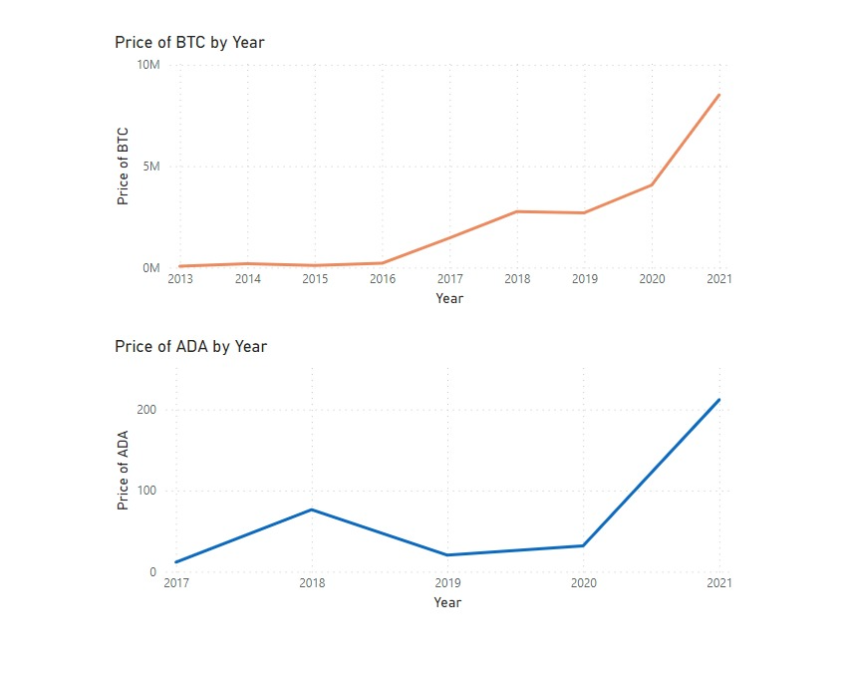
Visualization by PowerBi
Through our analysis, we inferred that Bitcoin influences the prices of all the other cryptocurrencies (also known as the Alt-coins). Here as you can see that starting from the year 2015 (when Ethereum was created) the Ethereum's price action follows the same trends as of Bitcoin's, when BTC is on a rise, Ethereum's price also rise and when BTC falls, Ethereum follows. The same is noticed in the other cryptocurrencies as well.

Slide 14
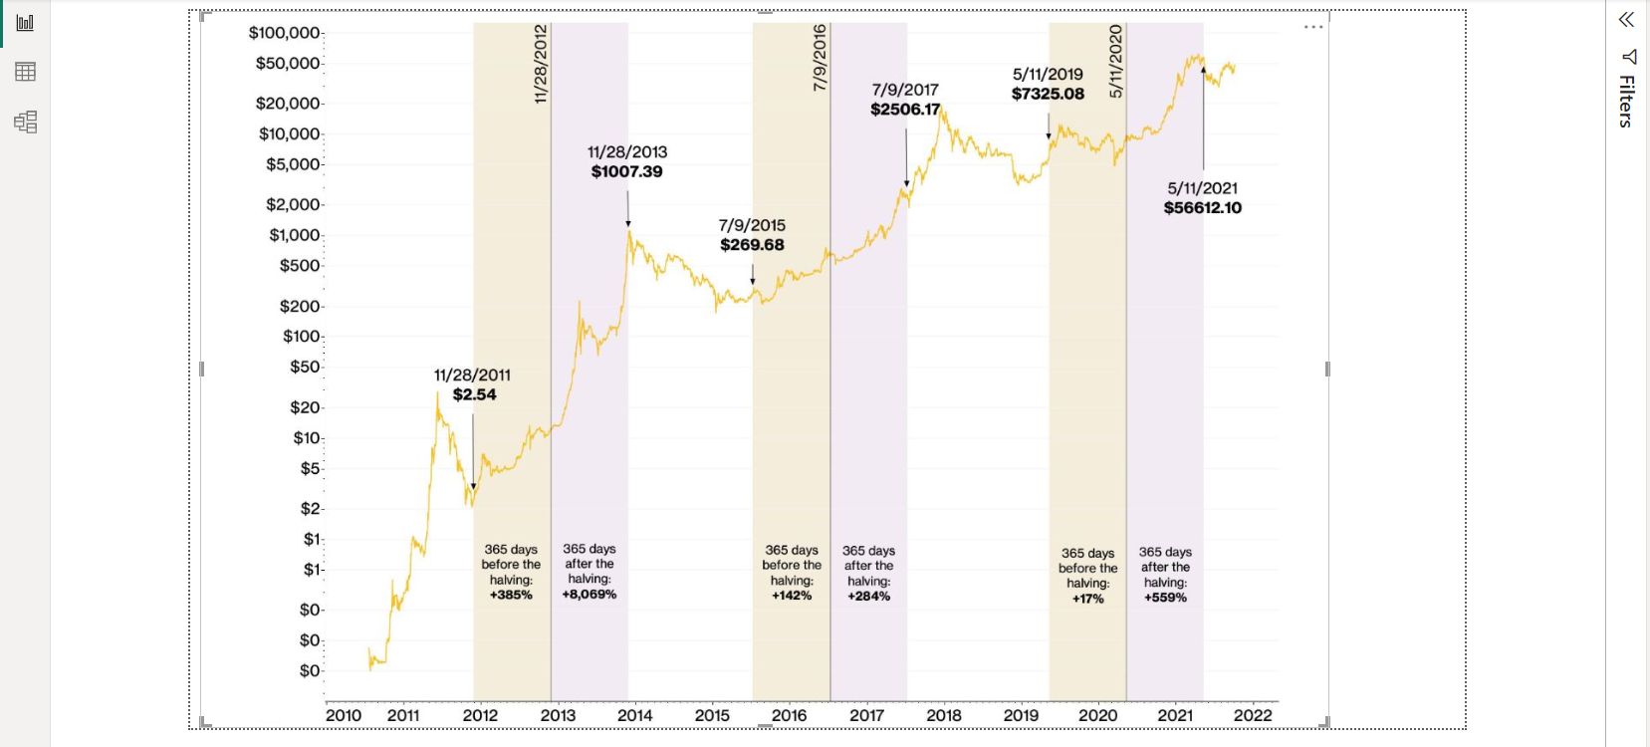
Bitcoin Halving Timeline

Slide 15
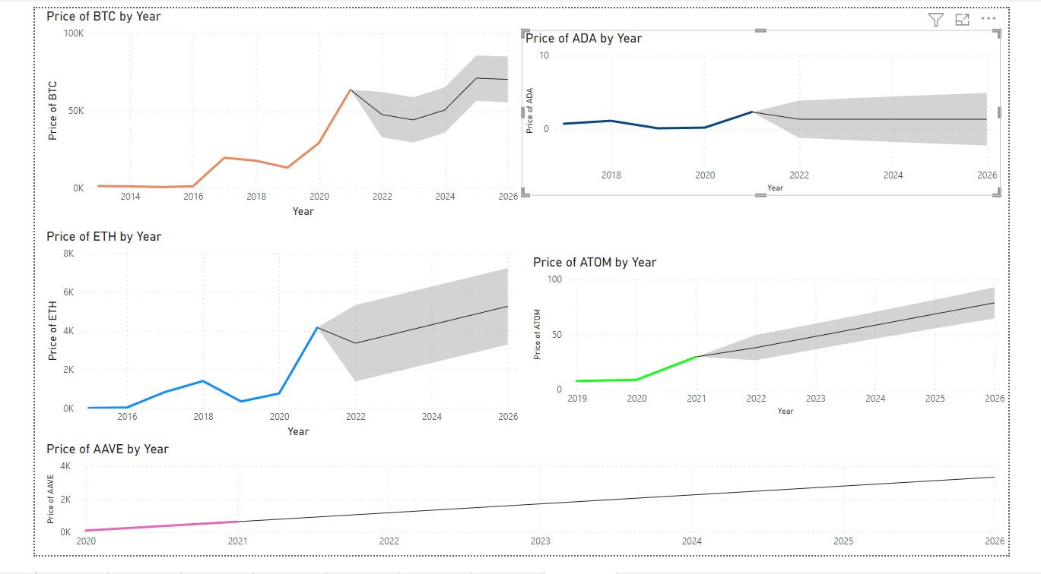
Forecasting

Slide 16

THANK YOU

